Slide 1
PROJECT IMPLEMENTATION PLAN FOR NATIONAL HYDROLOGY PROJECT
Sept. 14, 2015
NEW DELHI
NATIONAL INSTITUTE OF HYDROLOGY
ROORKEE

Slide 2
ACTIVITIES CARRIED OUT DURING HYDROLOGY PROJECT HP-I
TRAINING COURSES ORGANISED ON HYMOS, SURFACE AND GROUND WATER HYDROLOGY
R & D PROJECTS

Slide 3
ACTIVITIES CARRIED OUT DURING HYDROLOGY PROJECT HP-II
DEVELOPMENT OF DSS (PLANNING) FOR INTEGRATED WATER RESOURCES DEVELOPMENT & MANAGEMENT
Surface water planning
Integrated operation of reservoirs
Conjunctive surface water and ground planning
Drought monitoring, assessment and management
Management of both surface water and ground water quality
12 Purpose Driven Studies (PDS) carried out in HPII

Slide 4
PROJECT IMPLEMENTATION PLAN (PIP) NATIONAL HYDROLOGY PROJECT (NHP)

Slide 5
COMPONENTS OF NHP
Component A: Water Resources Data Acquisition System (WRDAS)
Component B: Water Resources Operation and Planning (WROP)
Component C: Water Resources Operation and Planning (WRPA)
Component D: Institutions Capacity Enhancement (ICE)

Slide 6
PROPOSED ACTIVITIES UNDER NHP
Component A: Water Resources Data Acquisition System (WRDAS)
Hydrological Instrumentation
HQ and regional centres

Slide 7
PROPOSED ACTIVITIES UNDER NHP
Component C: Water Resources Operation and Planning (WRPA)
Decision Support Systems Planning and applications
Purpose Driven Studies

Slide 8
PROPOSED ACTIVITIES UNDER NHP
Component D: Institutions Capacity Enhancement (ICE)
DSS Planning and applications
Institutional Modernization Support, incl. Centre for excellence in Hydrologic modelling
Strengthened Partnerships and study tours
Class room Training/Meetings and multi-media distance learning
Office infrastructure and furnishing, vehicles
Incremental staff cost
O & M cost

Slide 9
TRAINING AND PDS
NIH is assigned with two important tasks in NHP:
Planning and organising the training programmes for capacity building of the participating agencies.
Purpose Driven Studies (PDS): Initiation, Review and Monitoring.
Detailed guidelines for these tasks are under preparation.
TOR for these tasks have been prepared.

Slide 10
TOR for Training Section
National Training
Formulate the annual training programs in relevant areas as per need of various implementing agencies.
Prepare the training plan and contents of training course.
Organise training programs for imparting the training to the participants of the project implementing agencies in accordance with the approved annual training programs.
Organise some workshops/study tours at local or national levels to share the knowledge/ experience within the participating agencies and other stake holders and further develop inter agency collaborations.
Develop e-learning programmes and upload on the website for the benefit of various stake holders.

Slide 11
International Training
To identify the places of training and study tours as well as other requisite details for such activities for NIH scientists/other implementing agencies at the selected reputed universities and research institutions.
To facilitate the organizations of the training programs abroad for NIH Scientists at the selected reputed universities and research institutions.
To facilitate the organization of the short duration (up to 15 days) study tours for senior scientists of NIH at selected reputed universities and research institutions abroad to provide opportunity to update their knowledge with the advanced emerging techniques through interaction with the experts in the relevant area.

Slide 12
Terms of Reference of (TOR) of Expert Group
To finalize a road map for the training and capacity building programmes considering the hydrological problems and requirements of different implementing agencies.
To provide necessary inputs for designing the training programmes and interact with Implementing Agencies for reviewing the training needs.
To finalize Annual training calendar
To evolve a viable mechanism for the organization of training programmes in the States and Central Agencies for imparting the trainings on basic/advanced modern tools and techniques.
To develop a mechanism to monitor the progress of the training activities for the successful implementation of the capacity building programmes.
To finalize number of trainees and study tours from various implementing agencies at the selected academic and research institutions abroad.

Slide 13
PURPOSE DRIVEN STUDIES (PDS)
PDS is related to specific issues of water management problems identified within the area of operation of implementing agencies and of public concern.
The Terms of reference (TOR) of R&D Section are listed below:
To co-ordinate for R&D proposals to be taken up by the state and central agencies for purpose driven studies in the areas identified under NHP
To review the PDS by Expert members and approval of the PDS
To review and examine the progress of the project in conformance with the milestones, targets and objectives as contained in the proposal;
To disseminate research findings

Slide 14
Purpose Driven Studies
TOR for PI of PDS
Preparation and submission of PDS in prescribed format
Components/Expenditure Heads of Estimate
Remuneration/Emoluments for manpower
Travel Expenses
Infrastructure/Equipments
Experimental Charges
Consultancy charges
Contingencies
Procurement as per world bank procedure
Submission of Progress of PDS every six months
Submission of Project Report

Slide 15
Purpose Driven Studies
Thrust Areas
Impact of climate on water resources
Hydrological modeling
Prediction of ungauged basins
Stream flow simulation for snow/glacier fed rivers
Reservoir operation and Reservoir sedimentation
Flood modelling and management
Drought monitoring, mitigation & management
Ground water modelling and management
Hydrology of lakes and tanks
Salt water intrusion in coastal aquifers
Water quality monitoring and modeling

Slide 16
Constitution of Committee for PDS and Training
1. | Director, National Institute of Hydrology, Roorkee | Chairman
2. | Project Director (NHP), NIH, Roorkee | Member
3. | Representative from CWC not below the rank of Director | Member
4. | Representative from CGWB not below the rank of Director | Member
5. | Representative from MOWR, RD & GR | Member
6. | Representative, Central Water and Power Research Station (CWPRS) not below the rank of Scientist E | Member
7 to 10. | Four eminent experts/ academicians | Member
11 & 12 | Two representatives from State | Member
13. | Nodal Officer (NHP), NIH, Roorkee | Member
14. | Coordinator, Training, NIH, Roorkee (Member Secretary for Training) | Member
15. | Coordinator, PDS , NIH, Roorkee (Member Secretary for PDS) | Member

Slide 17
DSS Planning and Applications
DSS Implementation
HP-II States
New States
Training
Additional basins
Pilot basins in selected states
DSS(P) Applications and refinements
DSS Applications using a selected open source software e.g. WEAP / HEC ResSim etc. (depending upon scope)

Slide 18
Components
DSS Sustainability Aspects
New States
Collaboration with open source code developer team for interface customization, if required
ToT to NIH
HP-II states under NHP
Trainings on DSS(P), Mike Hydro, dashboard
Work for interface refinements
Additional dongles, if required
----------------------------------
Trainings by NIH

Slide 19
Centre for excellence for Hydrologic modelling
SWMU
( NIH + Project Scientists)
GWMU
( NIH + Project Scientists)
WQMU
( NIH + Project Scientists)
Integration of hydrological modules available in public domain + modules developed by NIH + interface development
Web- enabled models in public domain
E-learning of Hydrological modules
Selected PDS related with hydrological modeling

Slide 20
Facilities and Resources Required
Objective: To excel as an advanced knowledge centre for ‘Integrated Hydrologic Modeling’ and to develop advanced (web-enabled) Hydrological Modeling tools and techniques. Emphasis will be on use of Public Domain Software.
Workstation + accessories : 3
Computer + accessories : 12
Software (3 licenses each) : ArcGIS + Geostat + Matlab +
MODFLOW + WQ
Server : 1
Infrastructure development : Creation of work place (Green Lab)
Hired professionals : 3 subject experts +
3 IT experts(full time)
Foreign consultants : 12 man-months.

Slide 21
Strengthened Partnerships and study tours
Capacity building of NIH Scientists through international training on emerging technologies in hydrology and water resources.
Interaction of NIH Scientists with international academic, research and operational institutions through study tours.
Organisation of National level workshops/ study tours.

Slide 22
BUDGET AT A GLANCE UNDER NHP
Component A: Water Resources Data Acquisition System (WRDAS)
Items | Cost
Hydrological instruments | 7.0 Crore
Construction and renovation of HQ/RC | 3.75 Crore
Sub total | 10.75 Crore

Slide 23
BUDGET AT A GLANCE UNDER NHP
Component C: Water Resources Operation and Planning (WRPA)
Items | Cost
Decision Support System planning and applications | 14.5 Crore
Purpose Driven Studies | 11.0 Crore
Sub total | 25.5 Crore

Slide 24
BUDGET AT A GLANCE UNDER NHP
Component D: Institutions Capacity Enhancement
Items | Cost
Centre of Excellence for modelling and Waterpedia | 5.0 Crore
Project Management Unit | 1.5 Crore
Strengthened Partnerships and study tours | 5.0 Crore
Class room Training/Meetings and multi-media distance learning and seminar/Certificate, diploma courses etc. | 9.5 Crore
Incremental staff cost | 26.0 Crore
Recurrent O & M cost | 1.75 Crore
Sub total | 48.75 Crore
GRAND TOTAL ( Components A, C and D) | 85.00 Crore

Slide 25
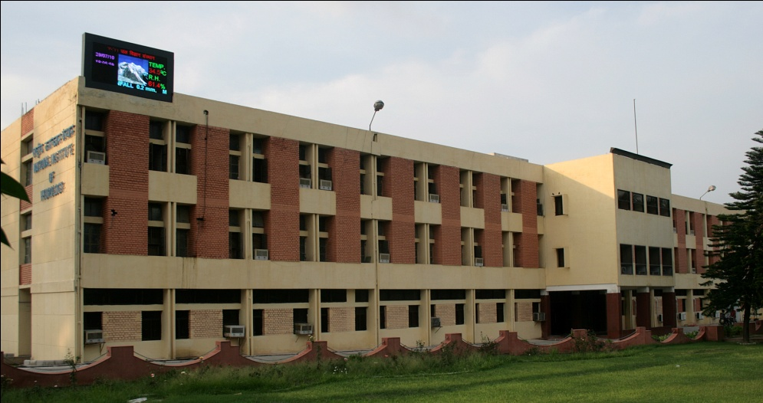
THANKS

